Slide 1
CONTENT AUTOMATION
Notes:
Automation can be applied to any phase of the content marketing strategy, including planning, creation, publishing and monitoring.

Slide 2
ABOUT
Content automation is a digital marketing strategy that focuses on removing the need for human intervention in the content lifecycle.

Slide 3
GOAL /REASON
The goal of content automation is to program, or automate, any process involved with Content marketing that may be redundant(no long needed or useful), time-consuming or costly.

Slide 4
How does content automation work
Content automation works by identifying repetitive content-related tasks and using tools or applications to perform them. Tasks that are often streamlined with content automation include search engine optimization (SEO), social media scheduling and tagging, target audience analytics and plagiarism checking. When the time it takes to complete these tasks is minimized, marketers can spend more time writing effective, original content.

Slide 5
Uses of Content Automation
Gathering published content for and sending automated emails to relevant customers or leads.
Sharing content across multiple platforms and social media
Optimizing content for search engines or similar competition.
Translating content into other languages, audio or graphics.
Creating a content creation and publishing schedule with notifications and reminders.
Curating content from other sources to share on social media.

Slide 6
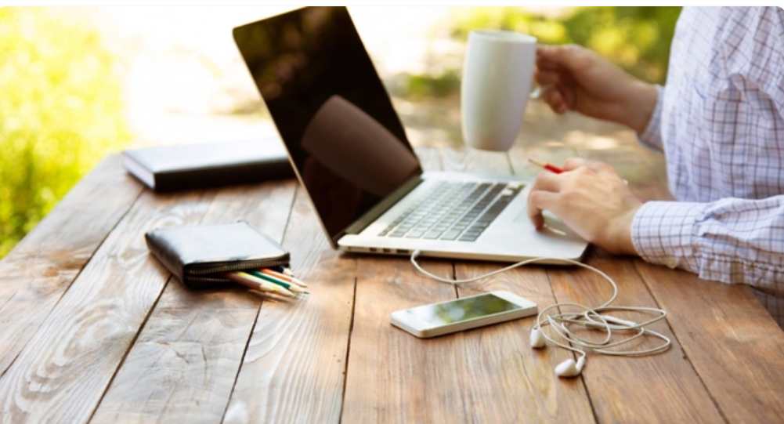
3 Simple Steps to Automate Your Content Marketing
Creating content marketing eats up your time. Here's how to use automation to get better, quicker results.
As a business owner who has to perform multiple tasks in a day -- sometimes simultaneously -- you likely appreciate the benefits of working with systems. Having systems in your business takes away some of the strain and helps you focus your energy on things that really need it.

Slide 7
1. Content curation
One of the best ways to build your brand’s online presence and grow your audience is by finding useful content and sharing it. In fact, one content-sharing rule suggests that five of every 10 social media updates you make should be content from others that is relevant to your audience.
That means curating great content. By automating this process, you get the advantages of not having to go out and find the content yourself, plus saving yourself time and providing your audience with relevant information on a regular basis.

Slide 8
2. Social sharing
Scheduling is one of the most important aspects of social media management. This allows you to share updates with your audience at the time that's best for them -- whether you yourself are online or not -- and save yourself time in the process.
Buffer does a great job in that respect. It was originally designed for Twitter but now you can also use Buffer for Facebook, LinkedIn and Google+. This integration with social channels gives you easy and automated sharing of social media posts -- including blog posts. To share, all you have to do is choose a time zone, then set the schedule.
The tool also allows you to add posts to a queue so you do

Slide 9
3. Monitoring
As you share your content across various channels, you’ll find it hard to keep up with the audience’s reaction. So you’ll need a tool that notifies you whenever your brand is mentioned.
A tool that allows you to do this automatically is Mention. Mention allows you to see all the mentions your name or brand gets across social platforms, websites and blogs from a single dashboard. It also allows you to reply to messages and engage with the audience straight from the dashboard.
To keep you abreast of all the mentions of you or your brand, Mention will send you an email update whenever the mentions occur. This helps you to respond to audience comments on time, boosting your engagement. With this, you can quickly address any questions or concerns about your brand from the audience.
In addition to tracking your brand, you can use it to monitor your competition by setting up relevant keywords: owner's name, brand name, specific pieces of content, etc.

Slide 10

Author
Major Myles

